Slide 1
Task one
File created on: 23/01/2021 7:07:20 PM

Slide 2
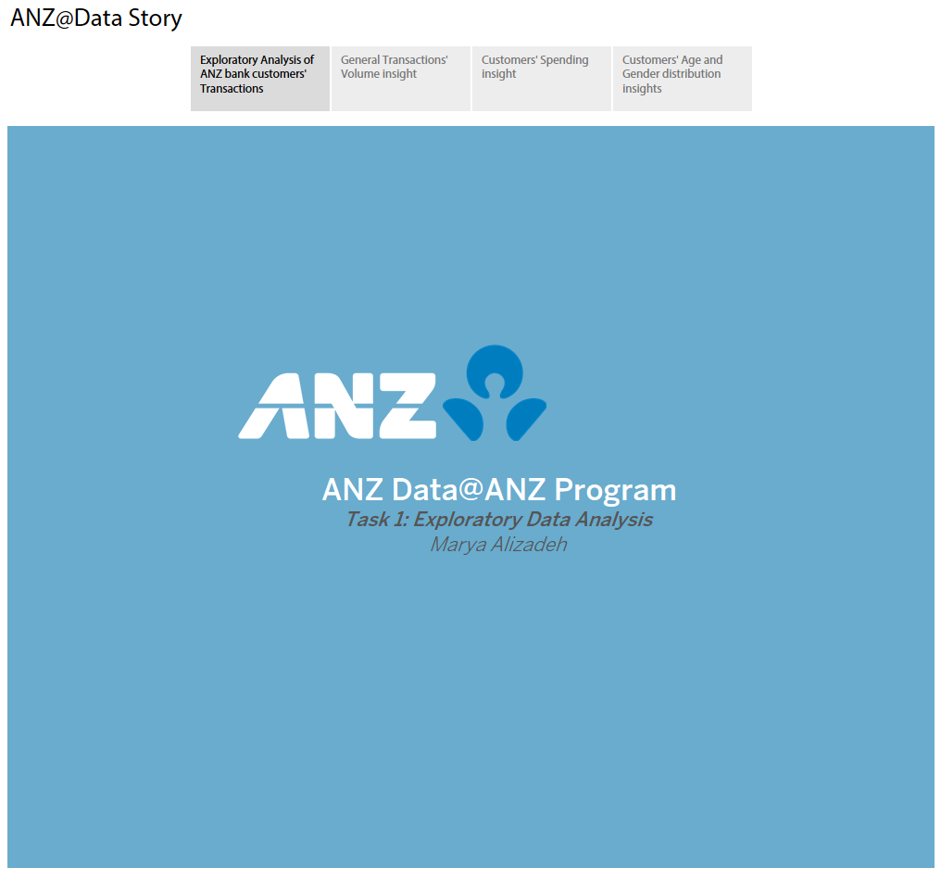

Slide 3
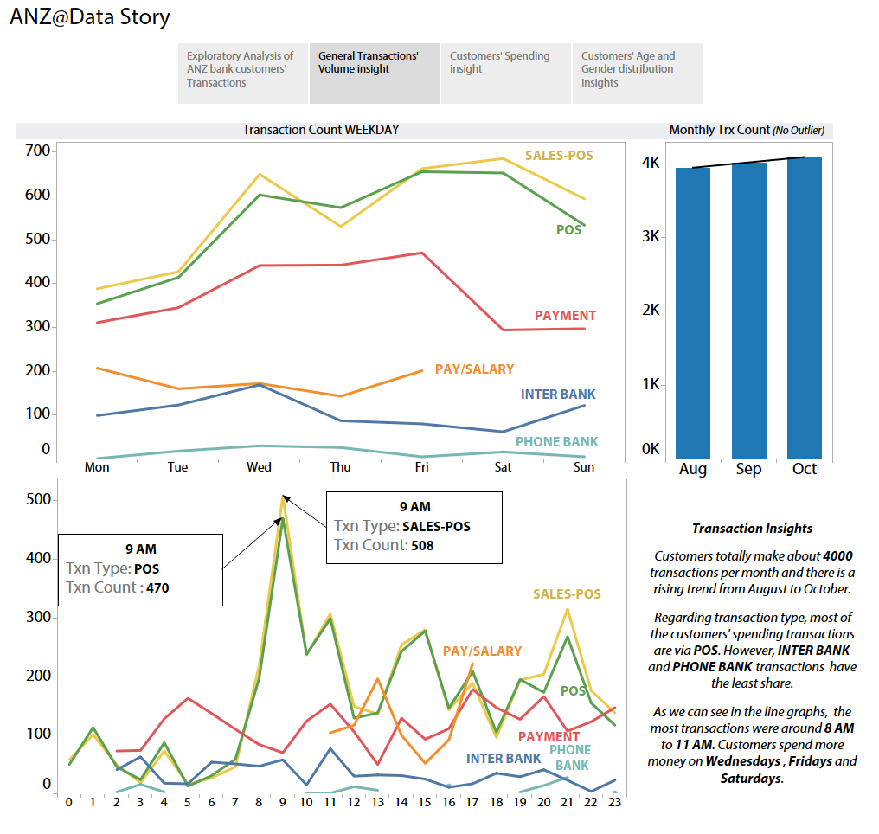

Slide 4
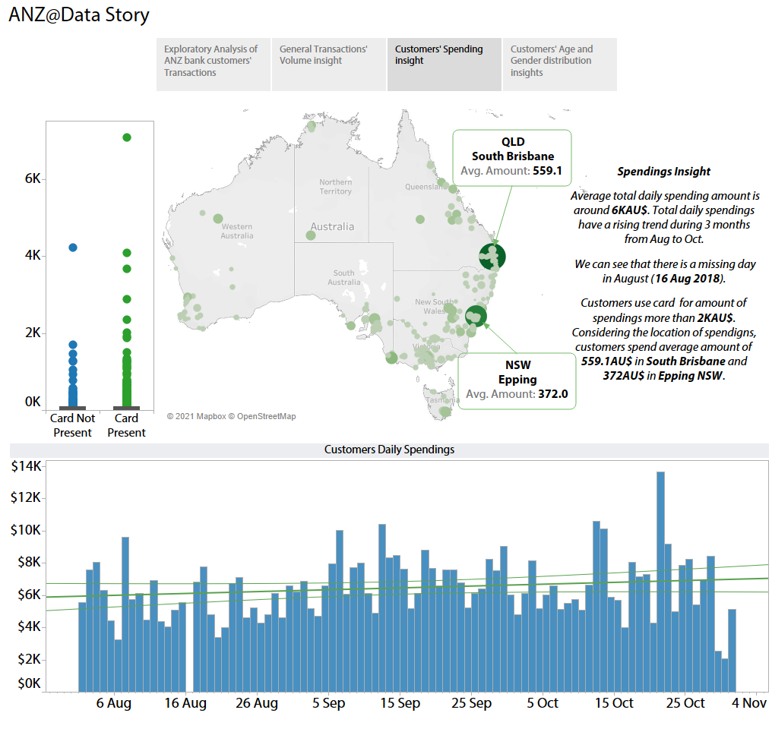

Slide 5
